Slide 1

Next-Gen Smart Pendant For Safe Navigation of the visually impaired
Shwetha.K.S.
Department of Computer Science & Engineering,
RV University, Bengaluru,
Karnataka, India.
shwethaks.btech23@rvu.edu.in
Vikas
Department of Computer Science & Engineering,
RV University, Bengaluru,
Karnataka, India.
vikas.btech23@rvu.edu.in
Arya.M.A
Department of Computer Science & Engineering,
RV University, Bengaluru,
Karnataka, India.
aryama.btech23@rvu.edu.in
Sunitha M T
Department of Computer Science & Engineering,
RV University, Bengaluru,
Karnataka, India.
sunithamt.btech23@rvu.edu.in
INSIGHT NAVIGATORS

Slide 2
INDEX
Page 3
Introduction
Page 4
Challenges in Navigation
Page 5
Need for a Smart Solution
Overview of the Smart Pendant
Page 6
How The Pendant Works
Page 7
Achieving High Accuracy
Page 8
Reliability of the System
Page 9
Design Features
Page 10
Benefits and Impacts
Page 11
Our Product Vs Other Product
Page 12
Future Enhancement
Page 13
References
Page 14
INSIGHT NAVIGATORS

Slide 3
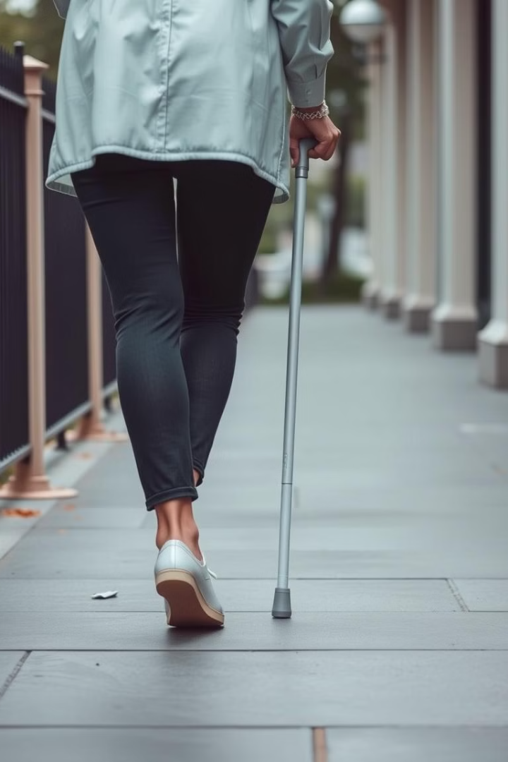
Introduction
Navigating the world can be challenging for individuals with visual impairments.
Traditional tools like walking sticks and guide dogs provide limited support, especially in unfamiliar environments.
1
Limited Range
2
Dependence
Traditional aids lack the ability to detect obstacles beyond their immediate vicinity, leaving users vulnerable to unexpected hazards.
Guide dogs require specialized training and care, presenting a significant barrier for many individuals.
3
Situational Limitations
Walking sticks are primarily useful for detecting obstacles on the ground, failing to detect overhanging objects or changes in elevation.
INSIGHT NAVIGATORS

Slide 4
Challenges in Navigation
Traditional tools often lack the ability to detect obstacles beyond the user's immediate reach.
Navigating daily life can be tough for people who are blind or have severe vision impairments. While tools
like walking sticks and guide dogs are helpful, they have limitations in detecting obstacles.
1
Navigating Crowds
When there are a lot of people around, it can be really hard for someone who is blind or has vision problems to get around. The usual tools they use, like walking sticks, don’t help much in finding and avoiding things in a crowd.
Outdoor Environments
Outside, there are often many things
that can be obstacles, like branches
that hang down, uneven ground, and
sudden ups and downs in the path.
Complex Environments
Busy urban areas, crowded public transport, and indoor spaces like malls or airports present unique challenges. These environments are often filled with dynamic obstacles and distractions, making navigation more complicated.
2
3
INSIGHT NAVIGATORS

Slide 5
Need for a Smart Solution
There is a clear need for a smart solution that provides more comprehensive and reliable obstacle detection.
A device that can detect obstacles both on the ground and in the air, allowing users to navigate with greater confidence and independence.
Enhanced Safety
1
The smart pendant provides an extra layer of safety, allowing users to detect and avoid obstacles they might otherwise miss.
2
Increased Independence
By offering real-time information about their surroundings, the pendant empowers users to navigate independently with greater ease.
Improved Quality of Life
3
The smart pendant can contribute to a more fulfilling and enjoyable experience for visually impaired individuals, allowing them to explore and engage with the world around them more freely.
INSIGHT NAVIGATORS

Slide 6
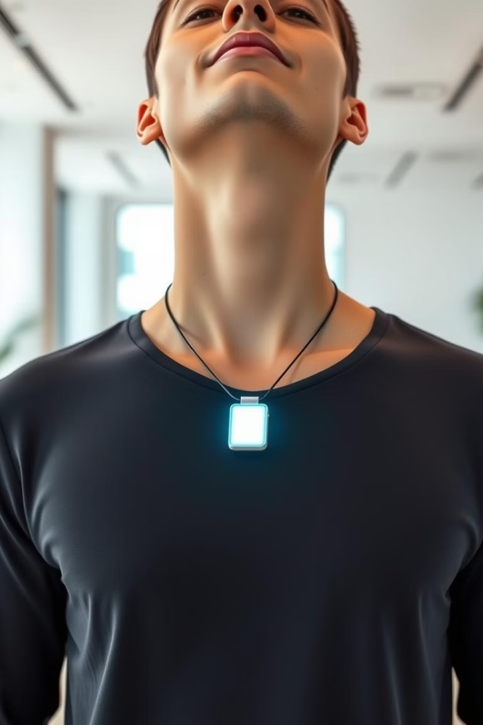
Overview of the Smart Pendant
The smart pendant is a wearable device designed to enhance spatial awareness for visually impaired individuals.
It features a compact and ergonomic design, making it comfortable and discreet to wear.
Obstacle Detection
Alert System
The pendant uses an ultrasonic sensor to detect obstacles in front of the user.
A built-in buzzer provides audible alerts to inform the user about the presence of obstacles.
User-Friendly Interface
The pendant is designed with ease of use in mind, allowing for intuitive operation and minimal learning curve.
INSIGHT NAVIGATORS

Slide 7



How the Pendant Works
The pendant uses a combination of advanced technology and intuitive design to provide a seamless and effective user experience.
At its core is an ultrasonic sensor that emits sound waves and analyzes their reflections to detect objects in front of the user.
Ultrasonic Sensor
Buzzer Operation
Microcontroller Analysis
The pendant uses an ultrasonic sensor to detect obstacles.
When the sensor detects an obstacle, the microcontroller activates the buzzer, which sounds louder as the obstacle gets closer, alerting the user.
It receives data from the sensors, processes that information, and checks if any obstacles are nearby. If an obstacle is detected, it sends a signal to the buzzer to alert the user.
Start
Activate Sensor
Start
Start
Send Sound Waves
Obstacle Detected?
Receive Data from Sensors
No
Wait for Reflection
Receive Reflected Waves
Yes
Process Sensor Data
Send Signal to Microcontroller
Calculate Distance
Check Obstacle Distance?
Microcontroller Activates Buzzer
No
Distance<Threshold?
No
Yes
Adjust Volume Based on Distance
Yes
Alert User
Is Obstacle Close?
End
End
End
INSIGHT NAVIGATORS
Module 1.1
Module 1.2
Module 1.3

Slide 8
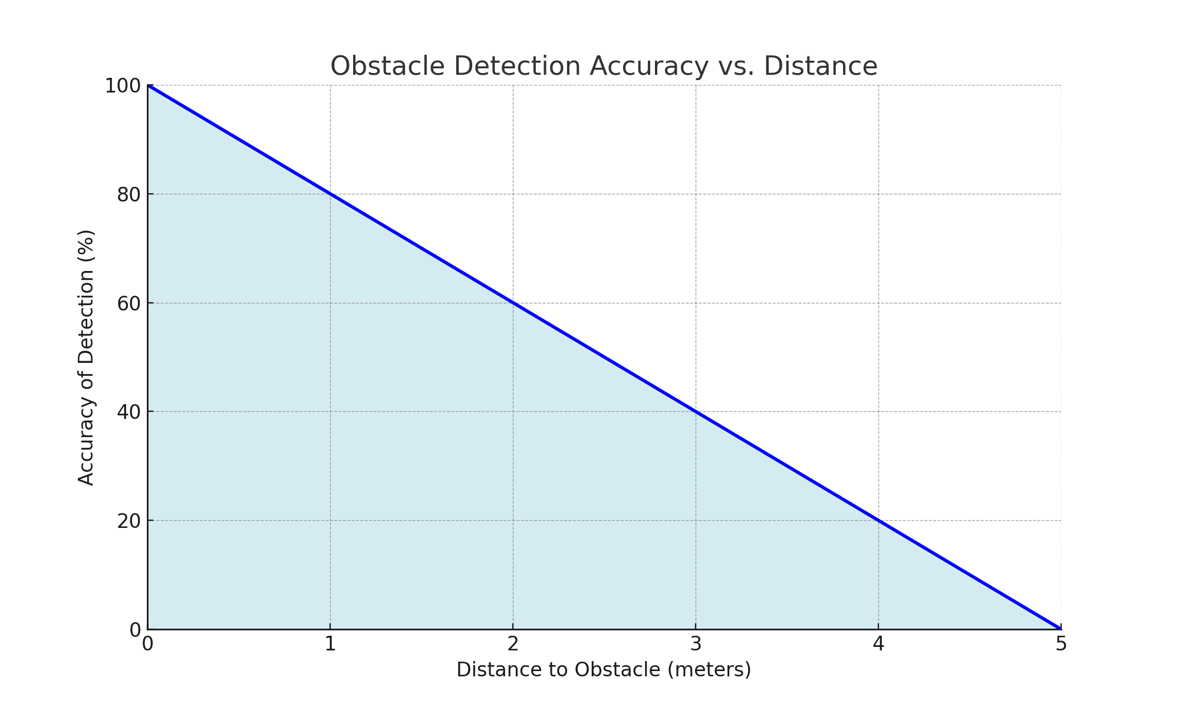
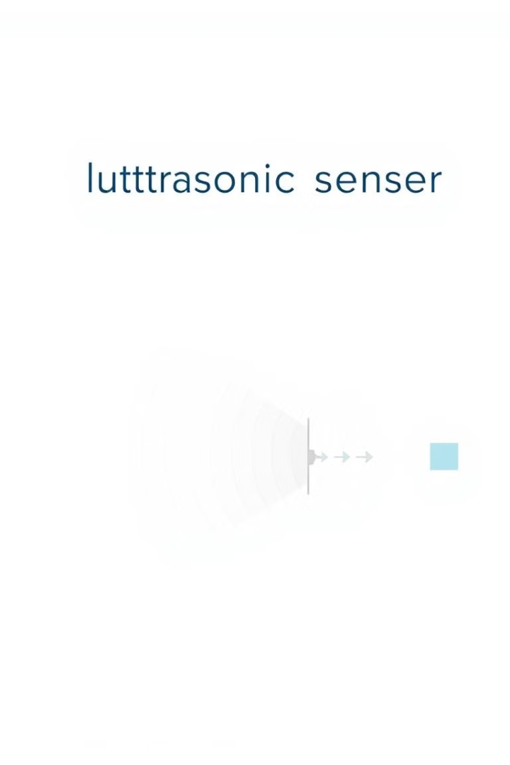
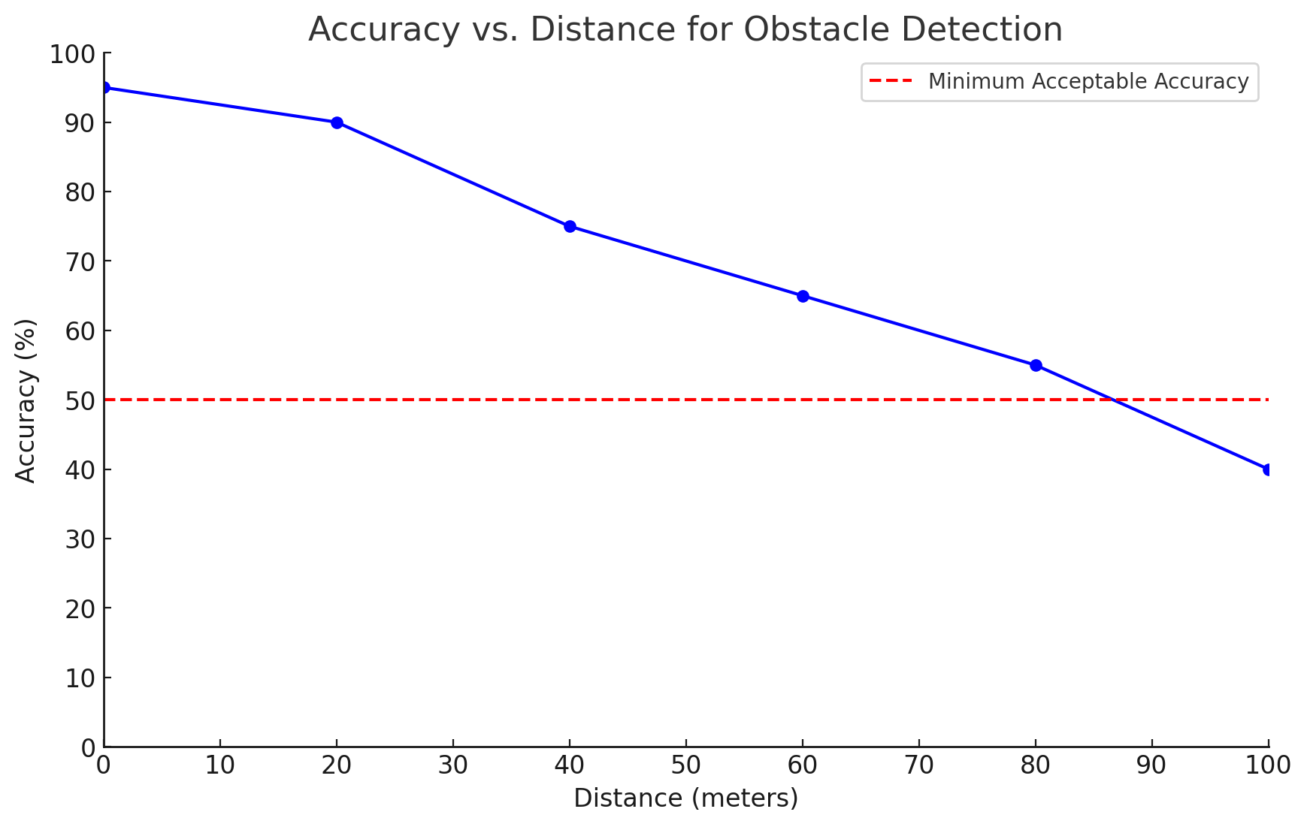
Achieving High Accuracy
The ultrasonic We aim to ensure that our smart pendant provides accurate obstacle detection
by using high-quality ultrasonic sensors. These sensors are positioned to cover different
angles around the user. The microcontroller quickly processes the information from the
sensors to alert the user about nearby obstacles. By fine-tuning the sensor's sensitivity and
response time, we can reduce the chances of false alarms, ensuring the user only gets
notified when necessary.
In the Graph 1.2,
X-Axis is Distance:
This axis represents the distance between the smart pendant and the obstacle, measured
in meters. The distance ranges from 0 to 100 meters.
Y-Axis is Accuracy:
This axis indicates the accuracy of obstacle detection, expressed as a percentage. A higher
percentage means better accuracy in identifying obstacles.
Graph 1.1
Graph 1.2 Interpretation:
As the distance increases, the accuracy tends to decrease. This means that the further away an obstacle is, the less accurately the pendant can detect it.
At short distances (e.g., 0 to 10 meters), the accuracy is very high, close to 100%. This indicates that the pendant is very reliable in detecting nearby obstacles.
As the distance approaches 100 meters, the accuracy drops significantly, indicating challenges in detecting obstacles accurately at greater distances.
Graph 1.2
INSIGHT NAVIGATORS

Slide 9
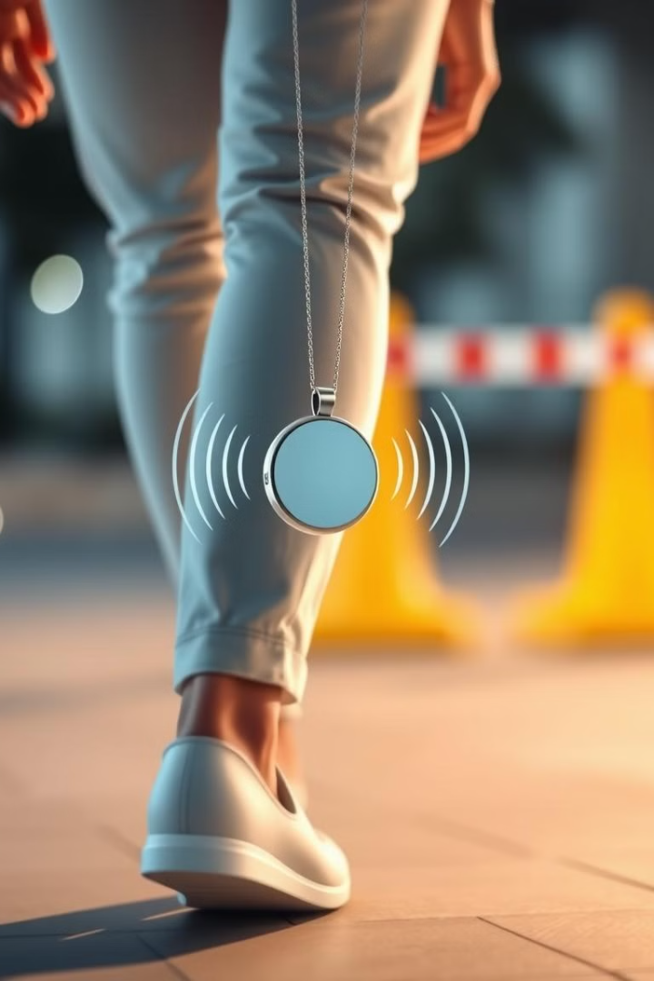
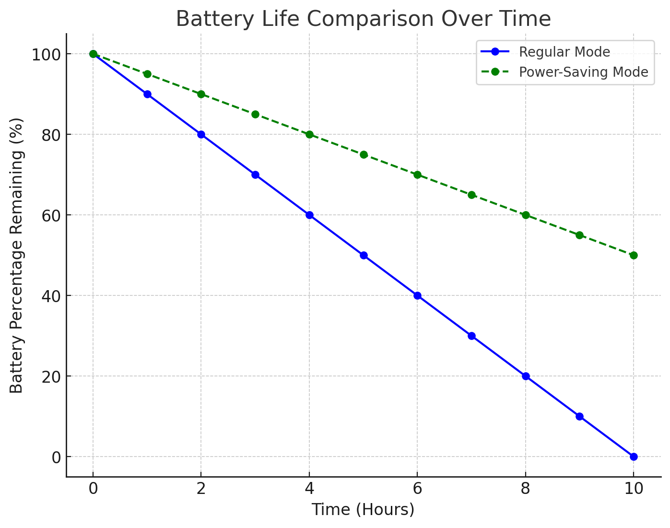
Reliability of the System
The reliability of the smart pendant is paramount for ensuring user safety and confidence. To achieve this, we are committed to using high-quality, durable components designed to withstand daily wear and tear. The pendant will undergo rigorous testing to confirm that it can handle various environmental conditions, such as moisture, temperature fluctuations, and physical impacts.
User Confidence: By focusing on these reliability factors, users can have peace of mind knowing that the smart pendant will work consistently across different situations. This confidence is essential for visually impaired individuals who rely on the device for safe navigation.
Power Management: A crucial aspect of reliability is our smart power management system. This system will monitor battery levels and optimize power consumption to extend battery life. If the battery begins to run low, the pendant will automatically switch to a power-saving mode, allowing it to continue functioning effectively until the user can recharge it. This feature ensures that users do not face unexpected shutdowns during crucial moments.
From Graph 1.3 ,
X-Axis (Time in Hours):
Represents the time in hours from when the battery is fully charged (100%) until it drains (0%).
Y-Axis (Battery Percentage):
Shows the remaining battery percentage from 100% (fully charged) to 0% (fully drained).
Regular Mode (Blue Line):
The battery drains steadily, losing about 10% of charge each hour. This mode depletes the battery entirely after 10 hours of usage.
Power-Saving Mode (Green Dashed Line):
In this mode, the battery drains more slowly compared to the regular mode, losing around 5% each hour. After 10 hours, the battery still retains 50% of its charge.
INSIGHT NAVIGATORS
Graph 1.3

Slide 10
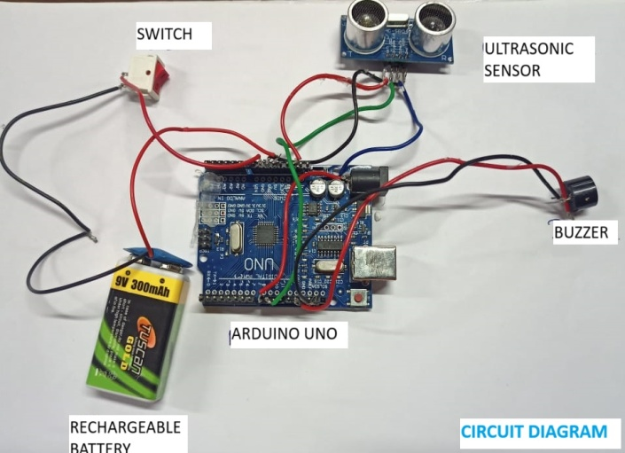
Design Features
Our pendant is designed to prioritize comfort and ease of use for visually impaired individuals.
It features a lightweight and compact design, with a smooth, ergonomic shape that fits comfortably
around the neck.
1
Lightweight and Compact
The pendant is designed to be lightweight and compact, ensuring comfortable wear for extended periods.
2
Ergonomic Design
The pendant's shape and size are optimized for comfortable wear around the neck, minimizing any potential discomfort or irritation.
3
User-Friendly Button
A single, easily accessible button on the pendant allows users to adjust settings or activate specific functions.
4
Battery Life Indicator
A user-friendly battery life indicator will alert users when it’s time to recharge, helping them avoid unexpected downtime.
INSIGHT NAVIGATORS

Slide 11
Benefits and Impacts
Customizable features to adapt to different user needs and environments, making it a more personalized assistive tool.
The smart pendant enhances the safety of visually impaired individuals by offering real-time obstacle detection and alerts.
Benefits
Impacts
A discreet and comfortable design that integrates seamlessly into the user's lifestyle.
It promotes independence, enabling users to navigate unfamiliar environments with more confidence.
Increased personal freedom and confidence in daily activities.
The pendant reduces reliance on traditional tools like walking sticks or guide dogs, empowering users to explore new areas.
INSIGHT NAVIGATORS

Slide 12
Our Product Vs Other Product
1.Obstacle Detection
Smart Pendant :
Detects obstacles at various heights and angles.
Provides hands-free navigation.
Gives sound alerts to warn about nearby obstacles.
Customizable to individual user needs.
Covers a larger detection range.
Easy to use for everyone.
Can integrate with smartphones for added features.
Lightweight and designed for all-day wear.
Walking stick :
Only detects ground-level obstacles.
Requires constant attention from the user.
No alerts; users have to be very aware.
No personal options available.
Limited range; relies on manual detection.
May require training to use effectively.
No technological integration.
Can feel heavy or uncomfortable after a while.
2.Navigation
3.Alerts
4.Customization
5.Detection Range
6.User Interaction
7.Technology Integration
8.Comfort
INSIGHT NAVIGATORS

Slide 13
Future Enhancement
In the future, we plan to improve the pendant by using more advanced sensors that can detect obstacles with even greater accuracy. We will also work on adding smart algorithms that can help the device understand the user's surroundings better. Additionally, we aim to make the device customizable, so it can be adjusted to meet the specific needs of different users and their environments. This will make the device more effective and personalized for each individual.
Improved Accuracy and Reliability
Use better sensors and smart algorithms to detect obstacles more accurately and reliably.
Affordability
Focus on using cheaper materials and production methods to make the device more affordable for more people.
Ease of Use
Make the device simpler to operate and connect it to smartphones for easier control.
Personalization
Allow users to customize alerts and adjust the device to different environments to meet their specific needs.
Integration with New Technologies
Explore wearable tech and connect the device with existing tools to enhance its functionality.
Durability
Design the device to last longer and be easy to repair for continued use.
Global Accessibility
Make the device available in more regions, especially in places with fewer resources, to help more people.
INSIGHT NAVIGATORS

Slide 14
References
[1].Shafi Ullah, Shabir Ahmed, Waqas Ahmad, Latif Jan, “Sensor Based Smart Stick for Blind Person Navigation,” Issue 3, Vol. 9, 2018.
[2].Dr. R. Thendral, A. Gayathri, P. Kalaivani, T. Kiruthika, “A Cloud Based Bus Alert System for Navigation of Blind People,” Issue 3, Vol. 5, 2018.
[3].Jinqiang Bai, Shiguo Lian, Member, IEEE, Zhaoxiang Liu, Kai Wang, Dijun Liu, “Virtual-Blind-Road Following Based Wearable,” Issue 3, Vol. 9, 2018.
[4].Giri.K1, Vinoth.C2, Sathish Kumar.U3, Naveen.R4, Prabath.K5, “Navigation Assistance for Visually Impaired People Using Node MCU,” Issue 6, Vol. 10, 2022.
[5].K. Rajan, E. Kalaiselvan, “Intelligent Navigation System for Blind People with Real-Time Tracking,” Issues: 22, Vol. 3, 2015.
[6].Sumukha S Puranik, Tejas S, Vaishnavi P, Vivek A Arcot, Paramesh R, “Smart Navigation Assistance System for Blind People,” Issues: 5, Vol. 9, 2022.
[7].Adnan Al-Samadi, Talal Al-Qaryouti, Abdurahman Rehan, Homam ASSI, Alhareth Alsharea, “A Navigation Tool for Visually Impaired and Blind People,” Issues: 5, Vol. 22, 2023.
[8].Chaitra Mahantesh Lokannavar, Kavya CK, Kavya SM, Priya G R, Vijayananda V Madlur, “IoT Based Navigation System for Visually Impaired People,” Issue: 05, Vol. 05, 2023.
[9].Pavitra M Gadhar, “Ultrasonic Navigation System for Blind,” Issue: 7, Vol. 9, July 2021.
[10].Sindhu Priyadharshini C, Surthi K, Ramya S S, “Blind People Navigation Using Alerting System,” Issue: 03, Vol. 05, March 2023.
[11].Kalpana Singh, Mansi Vashisht, Jyoti, Istuti Nirmal Saxena, Harshita Tyagi, Divya Saxena, “Navigation System for Blind People Using GPS & GSM Techniques,” Issue: 11, Vol. 3, 2022.
[12].Mrs. V.S. Benitha J. Sheryl, B. Mahalakshmi, “Smart Navigation System for Visually Impaired,” Issue: 05, Vol. 9, 2018.
[13].Mendoza, J., & Garcia, F, Urban Planning and Transportation Research, Vol. 25, Issue 3, pp. 220-235, 2023.
[14].Ramirez, M., & Diaz, L, Robotics and Autonomous Systems, Vol. 40, Issue 1, pp. 90-105, 2024.
[15].Gupta, A., & Sharma, P, Journal of Intelligent Systems, Vol. 32, Issue 2, pp. 160-175, 2024.
INSIGHT NAVIGATORS

Slide 15

THANK YOU
INSIGHT NAVIGATORS

